Slide 1
Center of Excellence’s Websites:
Your best friend
How to make the most of your website: It’s one of your best marketing, branding, awareness tools

Slide 2
Topics
An overview of the CoE for ICT website
Effective tools & techniques for strengthening your website
Social Media (Facebook, twitter, etc.)
How the Coe for ICT uses its website(Google analytics, evaluative data, blog, etc.)

Slide 3
An overview of the coeforict.org
Word Press (http://www.coeforict.org/wp-admin/index.php)
Google Analytics
Istock Photo (http://www.istockphoto.com/)
Vimeo (http://vimeo.com/)

Slide 4
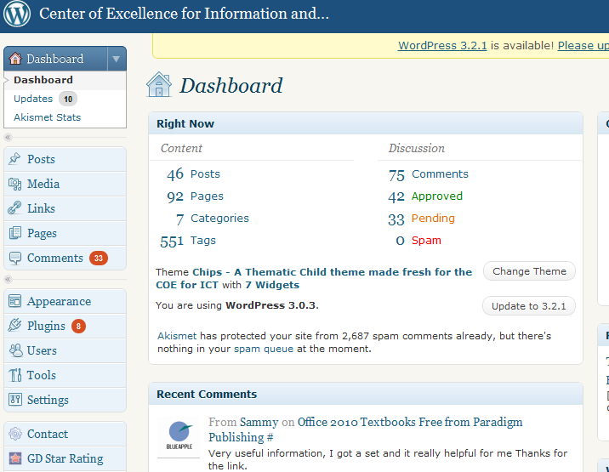
Dashboard
I’ll be taking you through a hopefully a quick post, and a
look at Google Analytics.

Slide 5
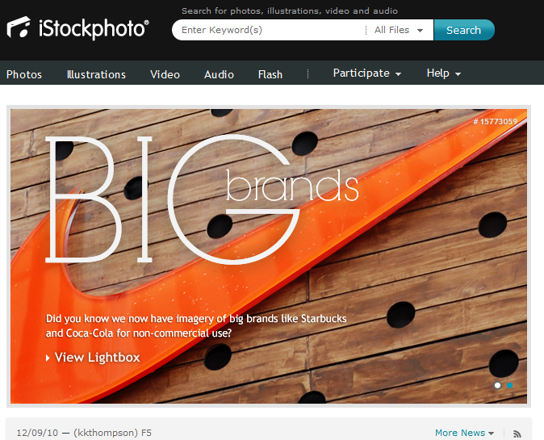
Istock Photo

Slide 6
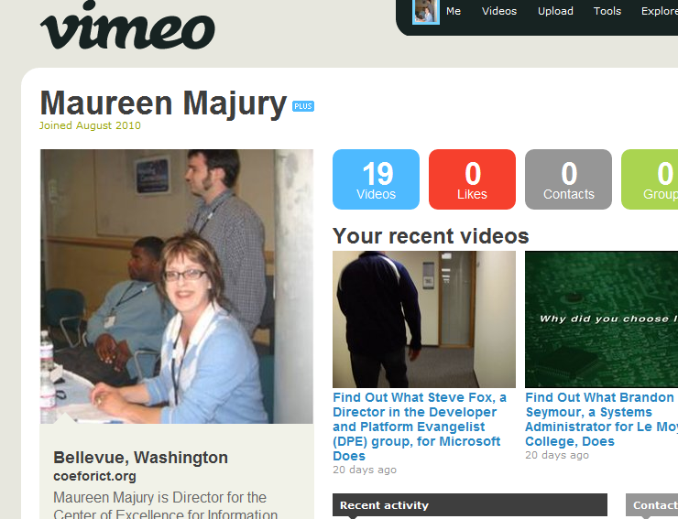
Vimeo

Slide 7
Effective Tools (Do & Don’t)
If you use a calendar think about how often you can check your website for updates. If it’s not once a week consider removing the calendar. If you are diligent, then it works.
Do date stamp updates if you feature them. It’s difficult for a visitor to assess news, if there is no date stamp. Or, archive featured Center news by month/year.
Do make a practice of publishing evaluative and ROI data on your website.
Do remember that video (unless it’s of a whole event) that’s informative should be between three and five minutes.
Do check your website in more than one browser, i.e. it might look great in Explorer, but content might not be apparent or aligned correctly in Chrome.
Do use photos and/or graphic images to attach to new posts, entries, etc. It enriches the UI experience.
Consider tweeting and having a Facebook account. The more you can generate traffic to your site, then better you can build your brand and create awareness about what your Center does for the CTC system.
Do use a survey and send out a series of questions about your website to your faculty. The best kind of feedback is honest feedback. And, it will help you improve your website. And, faculty will be pleased that you value their opinion.
If you haven’t already, do consider Google Analytics. It’s a great way to track who is visiting your site, and a reminder if the visitor number drops, you need to add some new and informative content.
Finally, pay attention to tagging your blog posts as it also drives traffic to your Center website.
You should add new content at least once a week. Or, update content and then “announce it” on your home page. It keeps visitors coming back because you are giving them a reason to come back.
Video, photos, news relevant to your industry sector that you can find by searching Google. If your main page is the same as when you first launched your site, w/no new content, update it posthaste!
Have an area to either archive past events, or remove them once they have been completed. Same goes for publications. No one likes to click on a PDF document that doesn’t have a date stamp on it to find out the information is two to three years old.
If you blog, you need to have a minimum of two new entries each month. Otherwise, consider retiring it.
If you have a resource “library” keep the documents/resources relevant and current.
Think of the space on your page. If there is too much text and/or information, the user will lose interest. Keep a lot of white space around text (less is more).
Don’t put the date of an event on your main page if you can’t change the date, or remove the event.
Don’t have an area for newsletters and there are no newsletters. Instead, tweet and have a feed onto your website.

Slide 8
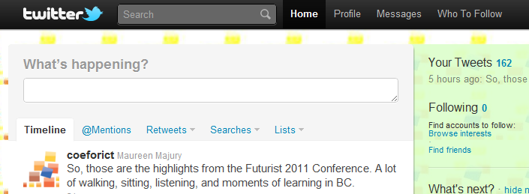
Social Media

Slide 9
Tweeting
Tweeting requires consistency.
If you decide to tweet, you need to tweet at least twice a day.
Make it interesting, vary your topics, welcome followers with a personal tweet, look at what interests them, and tweet about it.
Don’t take it personally if a follower stops following your Center’s tweet.
Google “tips on tweeting” for an overview.
An idea might be to ask your industry board or faculty for suggested tweets if you run out of ideas.
Tweet about conferences (Google “tips on tweeting at a conference”.)
Learn the acronyms you can use in tweeting. For example, u=you, 2=to, BTW=by the way. Use acronyms to stay within the 140 character limit.
Realize that unfortunately, punctuation is still important, but there are ways to really edit your 140 characters, w/o compromising the message or the perceived level of your intelligence.
Use tinyurl to shorten a URL.
Use tweet pics to load photos/images. First upload the photo then tweet. If you tweet and then upload the photo, your tweet disappears and you have to RT (or, retweet).
If at first you don’t succeed, tweet, tweet again!

Slide 10
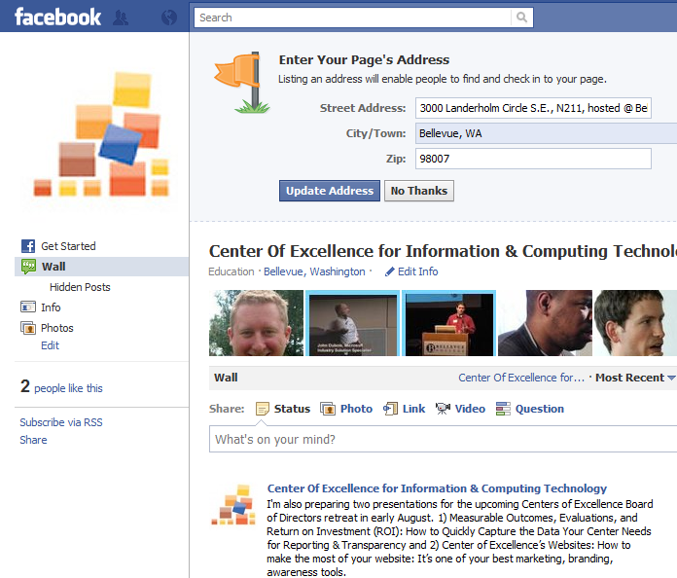
Facebook (or, Facespace)

Slide 11
Facebook Fan Page
This is an outward facing layer, which differentiates between the personal nature of Facebook, and the professional image you want to create for your Facebook acct. (Let me know if you want the instructions and I’ll email them to you).
You can directly link to your tweets and use LinkedIn to promote your Center.
Any way you can move traffic from Facebook and Twitter and YouTube to your website where you can drive traffic, is a great brand builder and people who are searching for a specific topic might stumble upon your website. And, then they will return if you keep content fresh and current.
Again, this requires a level of dedication, but as you keep at it, it really doesn’t take that much time, and the rewards are significant in terms of creating awareness and subsequently informing your visitors – especially when you don’t have a product, service, event, etc. to promote and naturally increase your traffic.

Slide 12
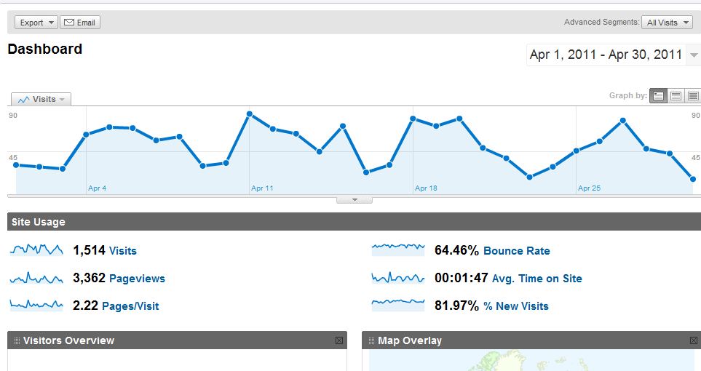
Finally, Google Analytics

