Slide 1
Your Future in IT is your all-in-one IT resource if you are a Washington State student. It is designed to help you successfully navigate your information technology (IT) academic plan, create awareness, and provide fun and factual information, tips, and suggestions on how you can best prepare yourself for your career in IT.

Slide 2
First: About the Center of Excellence for Information and Computing Technology
Headquartered at Bellevue College in Washington State, the Center of Excellence for Information and Computing Technology (CoE for ICT) is a statewide resource for:
Community and technical colleges
K-20 educational system
Information technology (ICT) industry
CoE for ICT, as an information resource and solutions-provider regarding model educational programs, supplies:
Best practices for ICT education and training
Up-to-date research, including IT trends that impact hiring and educational needs and business growth across industry sectors in Washington State
Information dissemination
K-20 faculty professional development conferences and student events
Let’s have a look under the hood: http//www.coeforict.org
Events I Resources I Research I Services I Blog

Slide 3
Your Future in IT: Purpose and Timeline
About the Site (Purpose):
It promotes understanding, awareness centered around the coursework K-12 students need to focus on to both create a seamless articulation as well as tips and advice that are designed to increase student success as they start their journey towards a information technology academic and career pathway
Students can set up an account and customized a coursework and extra-curricular activity planning guide that they can use to prepare for their four-year educational experience(whether it’s starting at a community and technical college and then continuing their B.A. or B.S. at a four-year university or college, or entering a four-year college or university directly
Short informational and awareness articles and resources that address how to overcome math-anxiety; why taking certain courses between grades 7-12 will enhance their two- or four year post-secondary journey; how to plan for the transition to the college or university experience; and, much, much more…
Awareness and targeted informational and awareness articles for young women and under-represented populations that support their access to tips and ideas that are designed to increase their interest and chances of succeeding in an IT educational and career pathway.
A searchable Washington State college and university information technology and computer science degree and certificate directory
Resources and informational pieces for parents, educators, and academic/career counselors
A What is YOUR Future in IT interest quiz (available by September 15, 2012)

Slide 4
Timeline (contd.)
Updated and re-validated with industry three academic/career program pathway planning guides (Let’s see what they look like) (January 2012)
Met with Terri Colbert and Venetia Willis-Holbrook to discuss how the Center could fund a website for the templates. (February 2012)
Created Website Goal Planning Sheet (March 2012)
Submitted and was awarded grant funding of $10K from Perkins (April 2012) (Tiffany Merkel)
Submitted and was awarded grant funding of $15K from Perkins (June 2012) (Terri Colbert)
Created the navigation, architecture; the back end of the IT Interest Survey; contracted for custom illustrations (logo and six IT kids); reworked and wrote identifying statements (See Word Document) and contracted for animating the survey (based on another quiz); wrote content for the pathways/the website/job descriptions, entered all the college/university degree information and tagged them so there can be a global search using keywords for the IT degree/certificate college/university online directory, etc. (February – Present 2012)
List of to-do’s (September 2012) (Word Document)

Slide 5
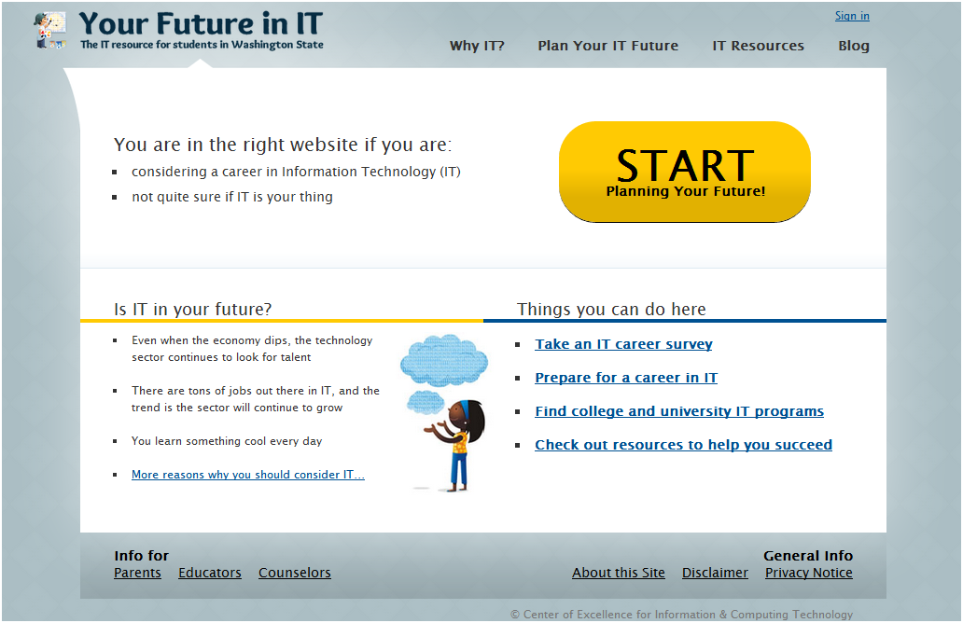
A Tour of the Website
Why IT?
Plan Your IT Future
IT Interest Quiz
IT Planning Pathway
Find a College or University Degree
IT Resources
For Students – Advice, Tips, Hints, Topics (short, informative pieces)
Blog
Info for
Parents
Educators
Counselors
About the site
Disclaimer

Slide 6
IT Programs of Study Common Course Number Initiative
The Center was invited to participate in a year-long Programs of Study (POS) project with the end goal identified as creating a POS template model. The Center updated the four IT templates based upon industry in-person interviews and a survey.
The Center discussed with OSPI and Workforce Board personnel:
The four updated IT POS templates, (with computer support specialist (technician, help desk) POS no longer viable due to lack of employment opportunities currently and five years out; if the employment landscape changes, then this POS template may be reinstated.
The best way to disseminate the templates and the ICT Directory’s information.
The Center suggested it would be able to develop an IT POS website, with the customizable templates and the ICT Directory information and test it by June 30, 2012. A design plan, goals and objectives, and a work plan have been developed with Bellevue College website professionals.
Discuss articulation agreements. Bring in all interested/vested parties (CTC, Tech Prep, CWU, EWU, OSPI, K-12, and OSPI math personnel) to focus on strengthening math skills, including statistics. 2) Bring together two-year and four-year educators to come to agreement on Programming course outcomes, as well as course outcomes for Data Structures | Additionally, on May 22, 2012 meeting with OSPI, SBCTC, the state’s Workforce Board, and Tech Prep directors, and other educators, determined the pathway of focus for statewide articulation to be Computer Programming. 2) See next slide for outcomes and next steps.

