Slide 1
Making Money in Marketplace
Today and Tomorrow
Analisa Roberts
Windows Phone Marketplace

Slide 2
Agenda
1 | Marketplace Basics
2 | What Makes a Great App?
3 | Be Part of the Mobile Ecosystem
4 | Questions & Answers

Slide 3
Marketplace Basics

Slide 4
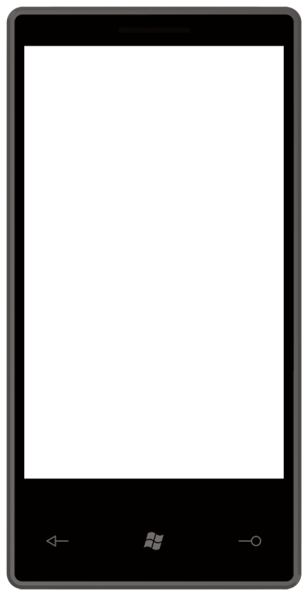
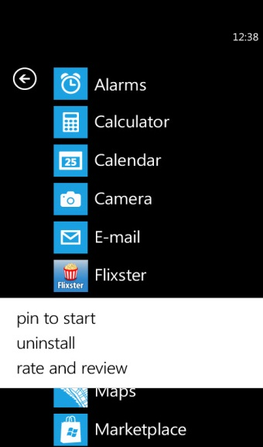
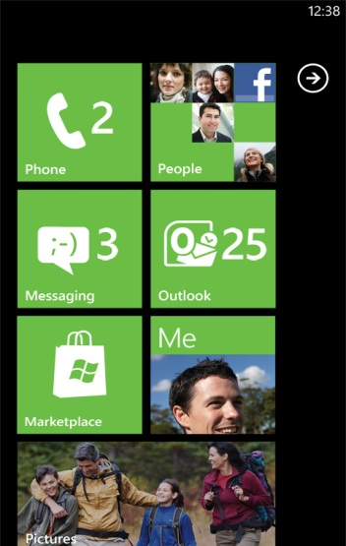
The Experience Begins at the Start Screen
START. APP LIST. PINNING.
1
  Easily access the Marketplace from the Start screen.
2
Pin favorite apps to the Start screen for quicker access.
3
  Organize and move tiles into your own personalized layout.
4
  Real-time updates and connection through live tiles.
5
  Tiles come to life with push notifications.
6
  Find apps in the App list or respective hubs.
Note: screenshots are subject to change and do not represent final build necessarily
Notes:
The Start screen is important because:
Start is the link into the Marketplace hub appears here as a Marketplace tile. Just click on the tile and jump to the Marketplace hub.
Start is the screen that users always see first. Whatever is on here is always top of mind.
Users can pin their favorite apps or games directly to the Start screen from the App list. Users can move app tiles around once pinned and position them in a way that makes sense for them.
Developers can push information to the live tiles that sit here – animate the tiles with information.
…and don’t forget the App list – in the above screenshot you can see how easy it is to pin the app to the Start screen (“add to quick launch”)

Slide 5
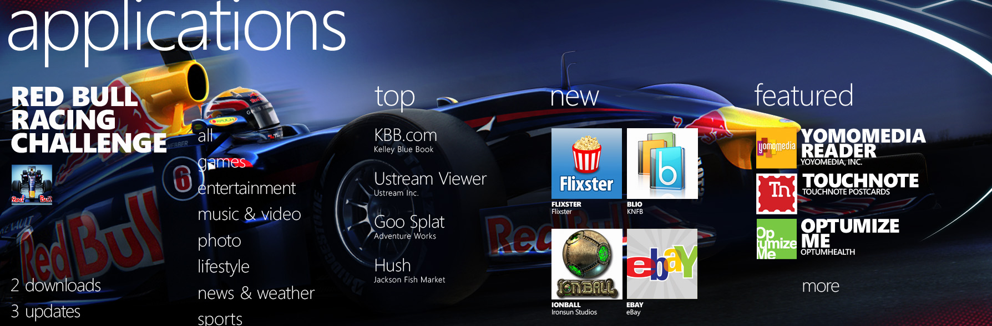
The Marketplace hub
  Single place to acquire applications, games, Xbox LIVE games, music, video content to personalize your Phone.
  Primary featured item controls the panoramic background, with additional featured on the main hub.
  Rotation of latest featured apps, games, music; encourages discovery.
  Horizontal flicking/panning adds depth to content experience.
Note: screenshots are subject to change and do not represent final build necessarily
Notes:
Marketplace is the single place for consumers to acquire content to personalize their Windows Phone
The Marketplace hub is where consumers go to acquire content, which after it’s acquired smartly organizes itself into other hubs (Games hub, Music + Video hub, or the App list to the right of the Start screen)
Marketplace is the only way for developers to distribute applications and games to Windows Phones, with Microsoft providing the software delivery service and update service for their applications
The Marketplace hub, has 7 active merchandising areas (featured item of the day and 6 featured items). The featured item of the day (eBay) controls the panoramic background
The primary featured item of the day is managed by the merchandising team to optimize for user engagement and will include both free and paid for applications
It will be optional for developers to provide a panoramic background image for their application, however highly recommended as an app cannot be promoted in the primary featured slot without one.
Items on the Marketplace hub change daily, per country
The list of content types in the center (applications, games, music, podcasts, contoso) indicate the content types available to a Marketplace consumer
“contoso” = the highly discoverable placeholder for a Partner brand, for exclusive content that they want to make available to their consumers
Any available updates are indicated at the bottom of this list of content types
All content acquired on-device via Windows Phone Marketplace is either download for free or acquired using real money (priced and collect in local currency)
Microsoft Points (used by Zune and Xbox LIVE) are not used on the device for purchasing any content

Slide 6
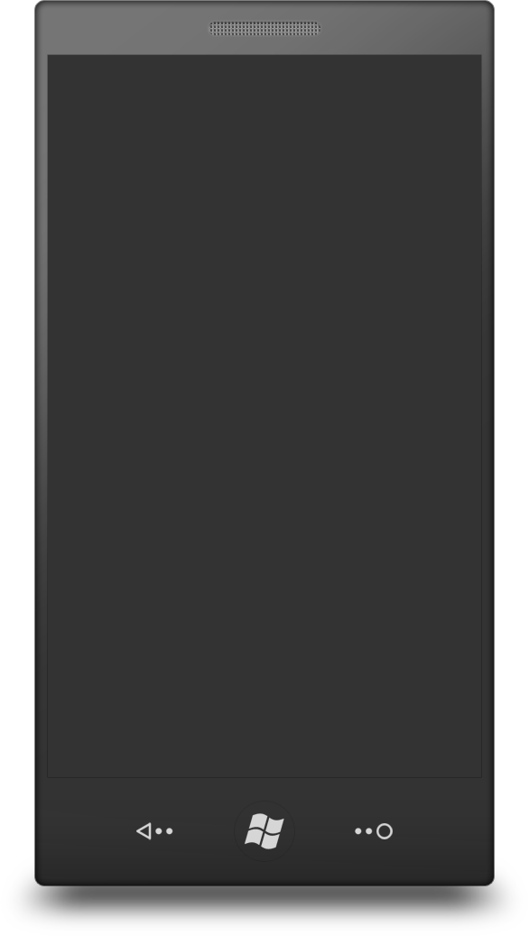
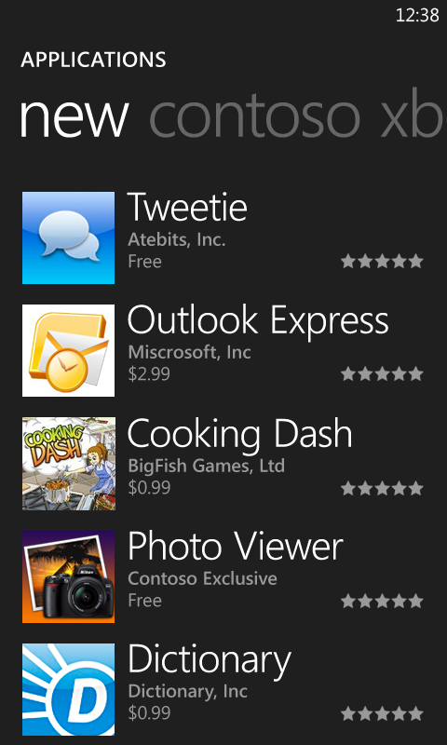
Highest Quality Apps
Every application on a Windows Phone 7 device will pass Marketplace certification.
Corporate vetting, technical and content policy testing ensures that applications are safe and high quality.
Focus on application quality and premium content drives consumer confidence, a higher rate of purchases and ASP (average sales price).
Consumer confidence establishes an ecosystem where developers invest and innovate vs. other platforms.
Consumer confidence and developer innovation drive revenue for Windows Phone Marketplace partners.

Slide 7
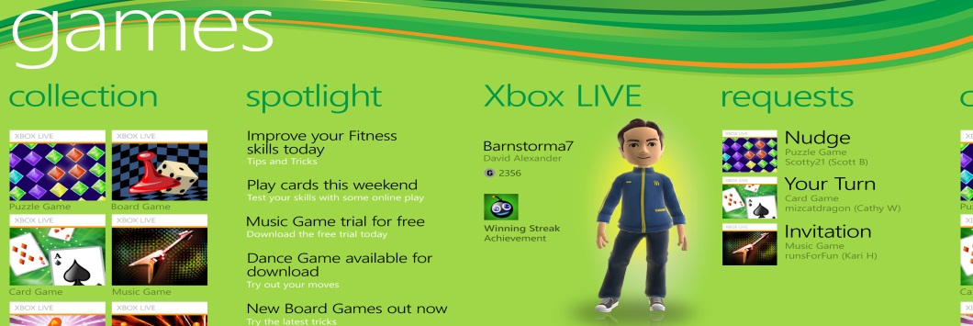
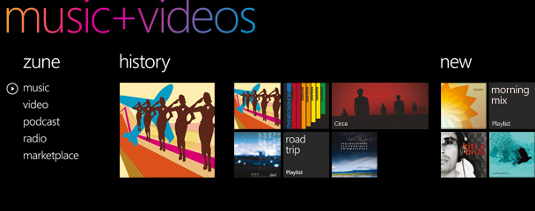
Hub Integration
Bringing content and apps together
CONNECTION WITH GAMES HUB
  Acquired gaming content appears in Games hub.
  Requests when friends nudge you for turn-by-turn games.
CONNECTION WITH MUSIC + VIDEO HUB
  Acquired music/video content appears in Music + Video hub.
  Browse and purchase from Marketplace on the Phone or PC.
Note: screenshots are subject to change and do not represent final build necessarily
Notes:
Key points:
Games and music + video purchased in Marketplace organizes itself into the respective Games and Music + Video hubs.
Marketplace apps, games and music + video also gets promoted in their own hubs and consumers click and browse to purchase, try or download.

Slide 8
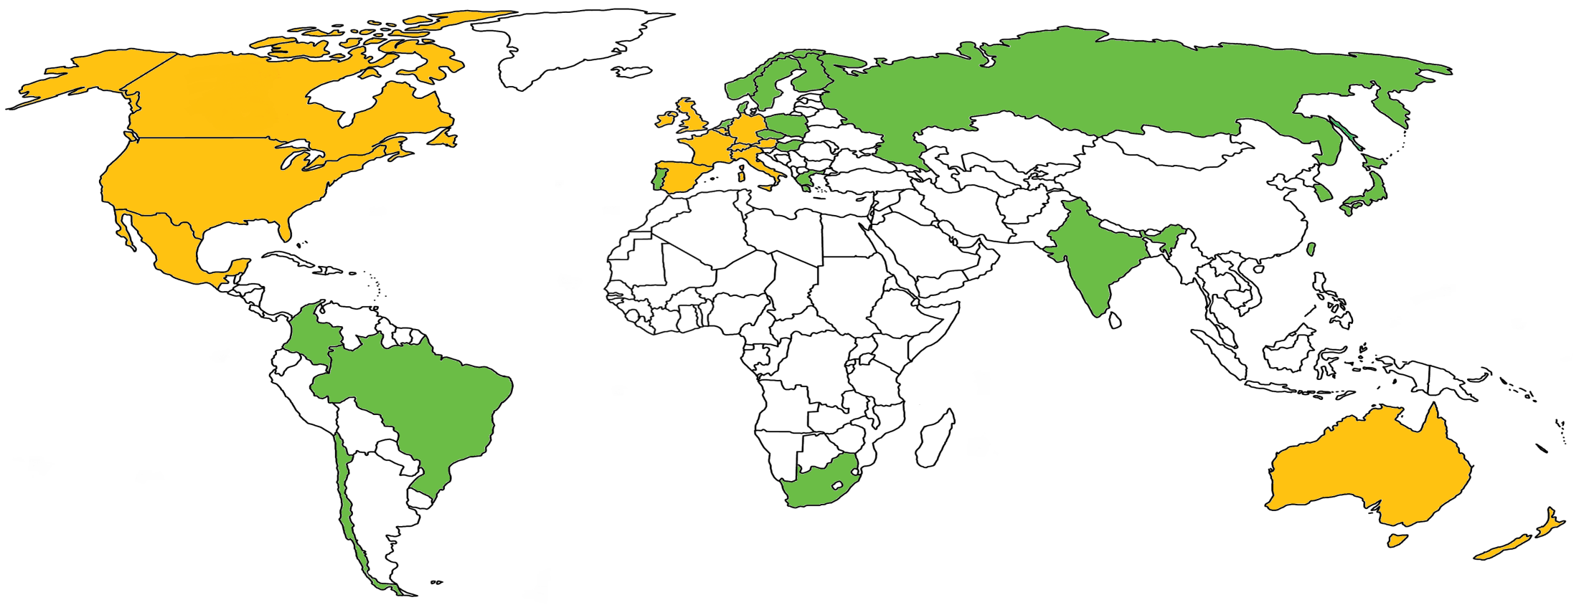

Marketplace Global Expansion
Today (16)
+ 19 New (35)
Hong Kong
Singapore
8
Notes:
Current Countries:
Australia
Austria
Belgium
Canada
France
Germany
Hong Kong
Ireland
Italy
Mexico
New Zealand
Singapore
Spain
Switzerland
US
USA
New Countries:
Brazil
Chile
Columbia
Czech Republic
Denmark
Finland
Greece
Hungary
India
Japan
Netherlands
Norway
Poland
Portugal
Russia
South Africa
South Korea
Sweden
Taiwan

Slide 9
Marketplace Languages
Currently Supported:
  English
  French
  Spanish
  Italian
  German
New Support:
  Japanese
  Portuguese & Brazilian Portuguese
  Dutch
  Simplified & Traditional Chinese
  Swedish
  Danish
  Finnish
  Norwegian
  Korean
  Russian
  Polish
  Greek
  Hungarian

Slide 10
Great Apps= Money

Slide 11
What We Look for in Great Apps
Great Apps . . .
Stand Out - Look and feel as if they are designed for and integral part of Windows Phone 7
Are Useful – providing expected feature set, presented with visual impact, that compels frequent use in a new way
Work as promised, include quality content, and are easy to use
Delight
Utility
Functionality
Great Apps start with strong functionality, add device-focused utility, and finish with a delightful WP7 user experience

Slide 12
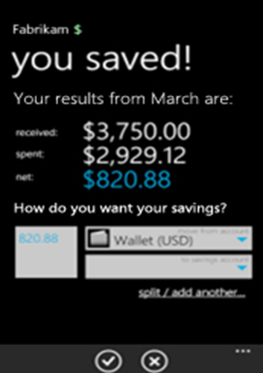

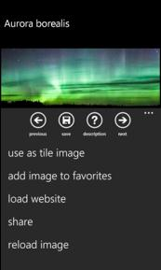
Functionality
Works as promised, includes quality content, and is easy to use
  Highly Functional apps work as promised, include quality content and are easy to use
Core Functionality | Content Quality | Ease of Use
Outstanding performance. Quick loading. Does not hang or crash. | Content is dynamic or exceptionally well prepared. Description and metadata help sell the app | First use of the app is intuitive and reassuring. Advanced features are discoverable and understandable

Slide 13
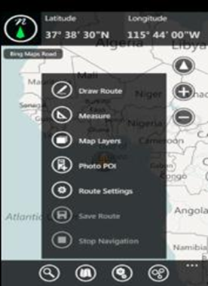
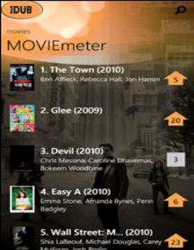
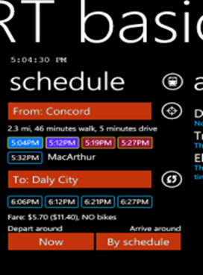
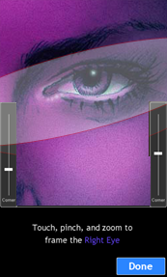
Utility
Incorporates mobile features and visual impact that compel frequent use
Feature Set | Visual Impact | Stickiness | Originality
App takes full advantage of device features and mobile scenarios and surprises with unexpected capabilities | Great use of color, graphic placement, and visual elements | Apps that are likely to compel frequent and repeated use. | Concepts that push the boundaries for mobile apps, offering innovative features or best-in-category innovation
  Useful apps allow users to do new things and frequently enable creation and sharing, not just consumption of content

Slide 14
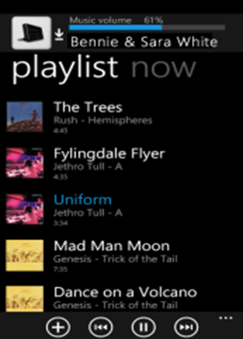
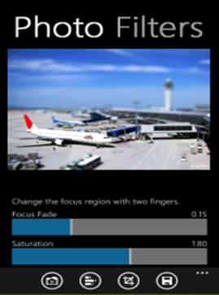
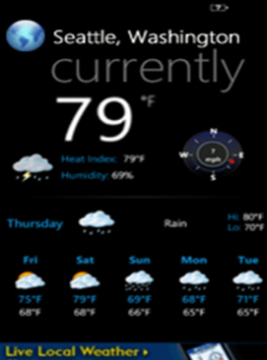
Delight
Looks and feels like an integral part of Windows Phone
Wow Factor | WP7 Design Language | WP7 Platform Features
Amazing app capabilities that make the user smile and inspires “Show and Tell” behavior | Makes full use of WP7 design language elements (controls, iconography, font). Uncluttered, polished clean experience | Best adoption of Windows Phone 7 platform features (Live Tiles, push notifications, Hub Integration)

Slide 15
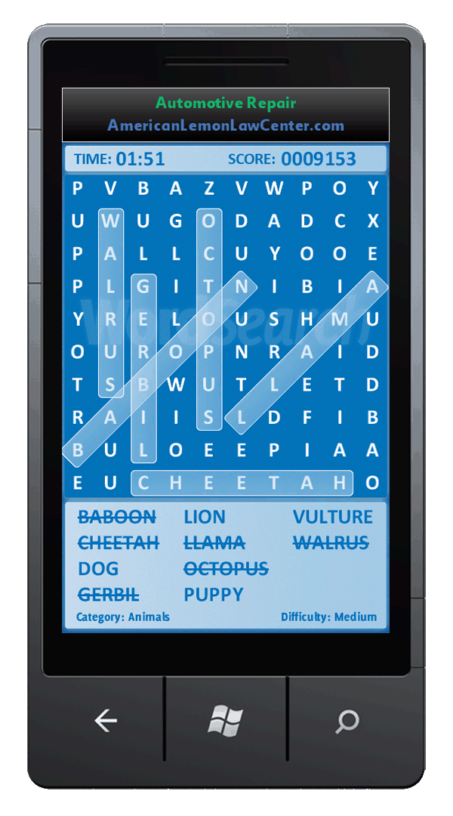
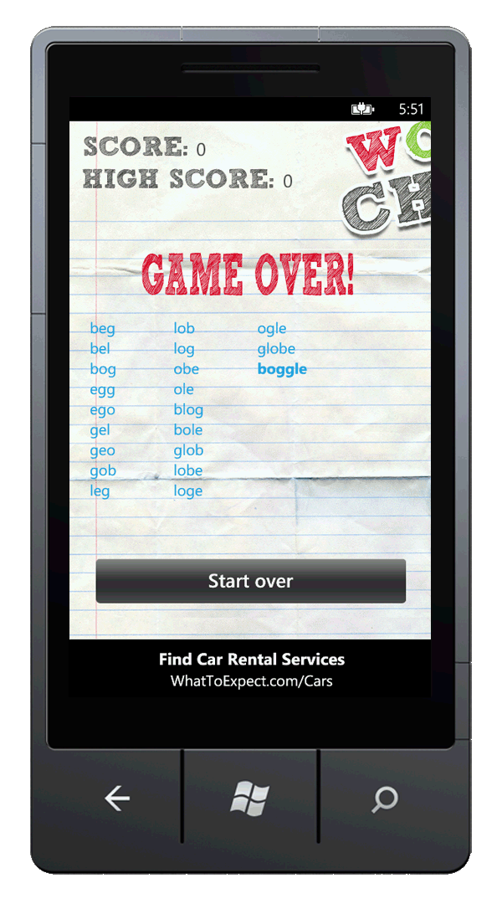
Making Money with Advertising
Microsoft Ad Control
  Supports both Silverlight and XNA
  Click-to-web and Click-to-call
  More markets coming in 2H2011
Best monetization
  Microsoft Ad Exchange
  Multiple top-tier mobile ad networks competing in real-time for each ad request
  Better demographic targeting via WLID
  You keep 70% of all ad revenue
pubCenter (http://pubcenter.microsoft.com)

Slide 16

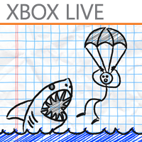



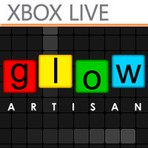



Managed Indie Games
Microsoft Games Studio
  Program for independent game publishers to bring premium mobile games to Windows Phone 7 and Xbox LIVE®
  Access to Xbox LIVE services and promotion
Great Games wanted
  Games of all types welcome
  Minimum Price Point of $2.99
XBox.com (mobilegames@microsoft.com)
  Mobile, Console, PC

Slide 17
The Mobile Ecosystem

Slide 18


Microsoft DreamSpark Program
Dream Today. Create Tomorrow
Goal of the program is to give students professional tools at no charge
Free Windows Phone Marketplace developer account: create.msdn.com
Beginning submitting apps and learn first hand about the mobile ecosystem

Slide 19
Marketplace Distribution Options
 | “Beta” | Private | Public
Number of users | 100 (1) | unlimited | unlimited
App Price | Must be “free” | Can be “paid” | Can be “paid”
Time Limited | Yes, expires after 90d | No | No
Updateable | No | Yes | Yes
Certification Required | No | Yes | Yes
Publicly Discoverable | No | No (2) | Yes
Access Control | Yes, limited to test user WLIDs provided | No | No
Target Users | Beta users | Private Users | Public Users
Preliminary, subject to change
People who obtain deeplink can access

Slide 20
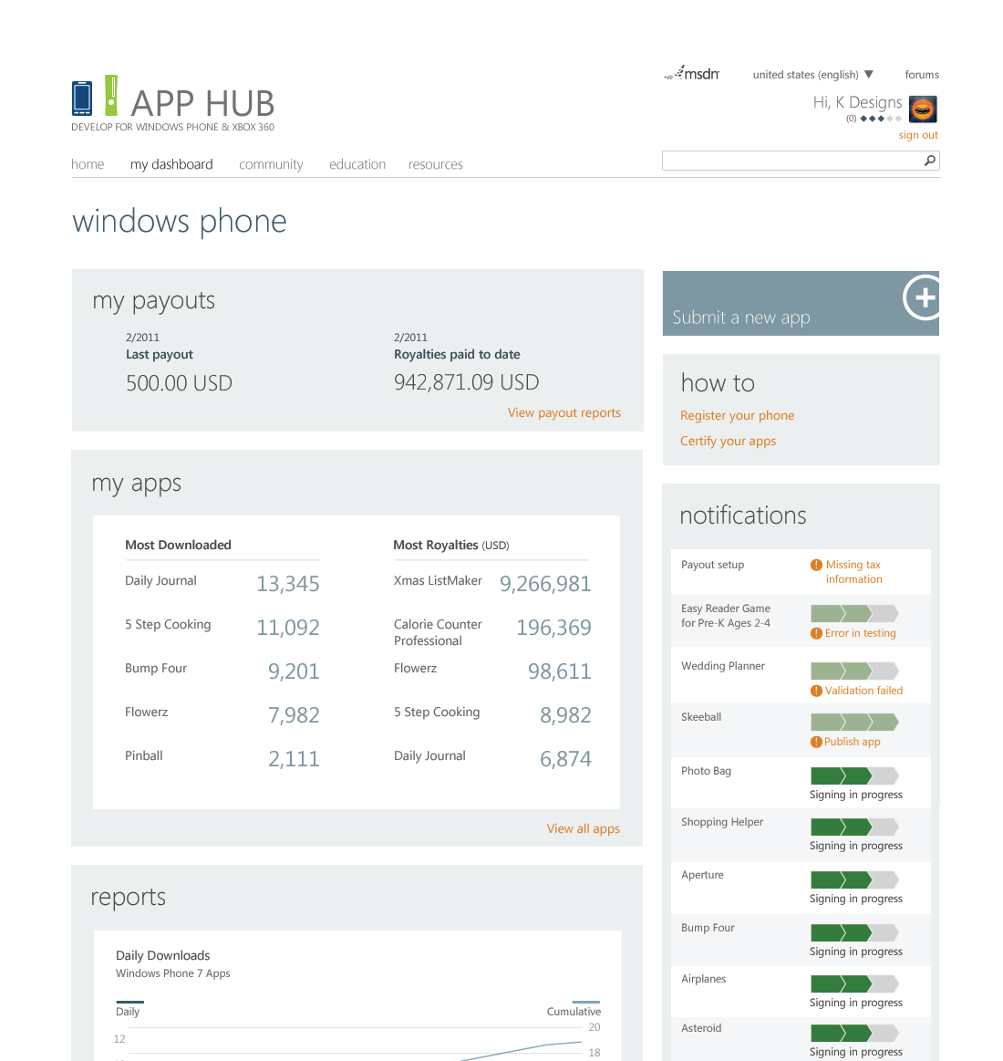
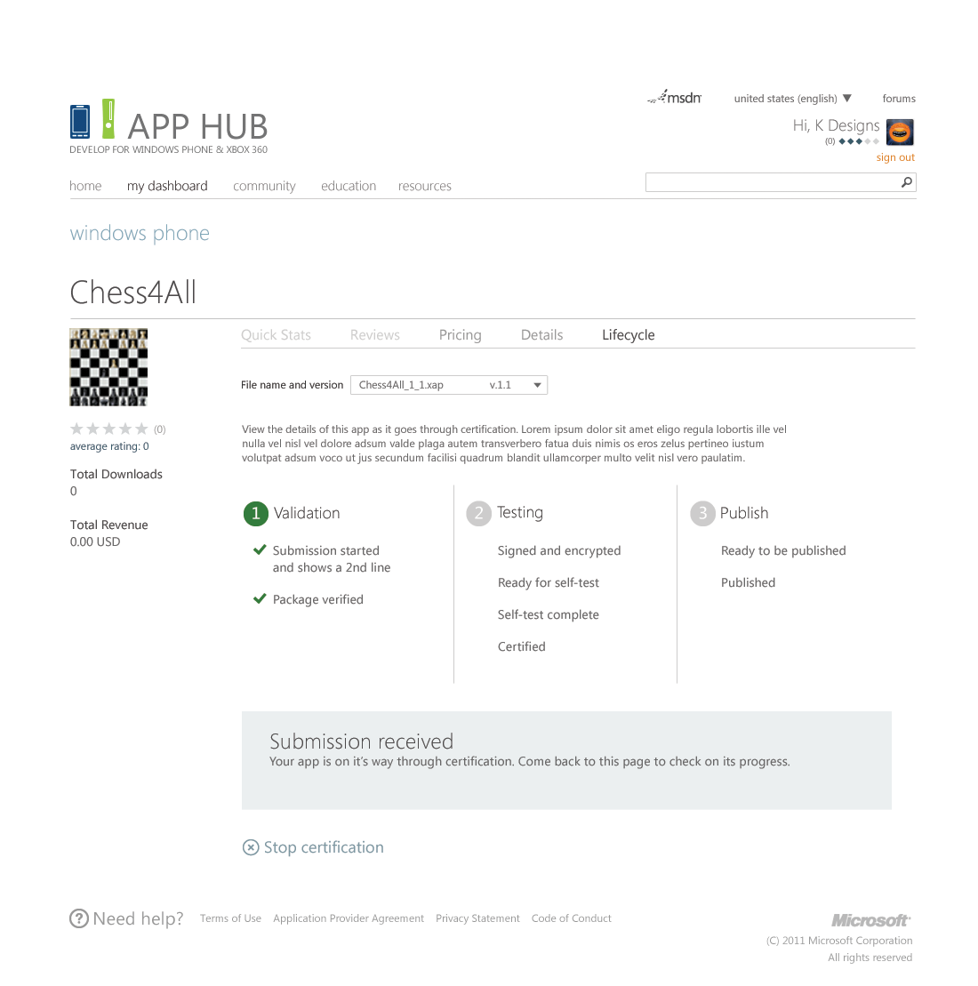
Reporting
Track Your App’s Success
Highlights all your apps by downloads and royalties
Data on daily downloads shown on dashboard
Clear notifications for any actions needed and status of app through cert process
Shows payout amounts to track money earned till date
UI and Screenshots are representative of UI, subject to change

Slide 21
Questions?

Slide 23
A Growing Exchange of Value
Large and Growing Selection of Apps & Games | 13,123 certified applications and games Growing at over 100 new apps per day 61% Paid, 39% Free 61 exclusive Xbox LIVE games
From Many Developers | 38,191 developers registered 7,300+ developers have submitted one or more apps 1,200 new developers every week
Loved by Users | 12 Downloads per User per Month 10% Conversion rate from Trial to Paid Purchase Daily Merchandising drives 500% download uplift
Generating High ARPU | MO Billing now available to over 50% of Windows Phone users % Paid Downloads: 3.2% Paid Apps Average Selling Price: $2.93; High ad monetization rate

