Slide 1
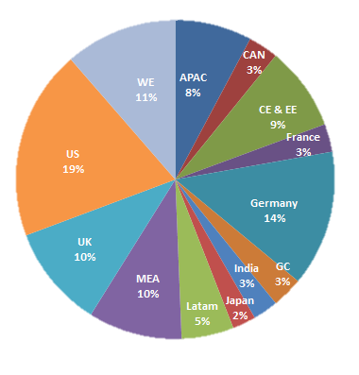
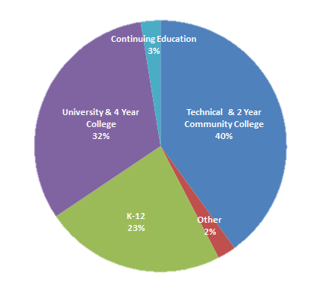
Where ITA is Today
A13 Breakdown
Institution Type Breakdown

Slide 2
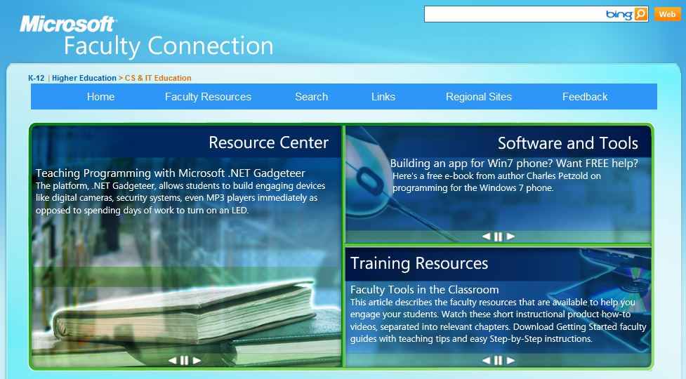

Slide 3
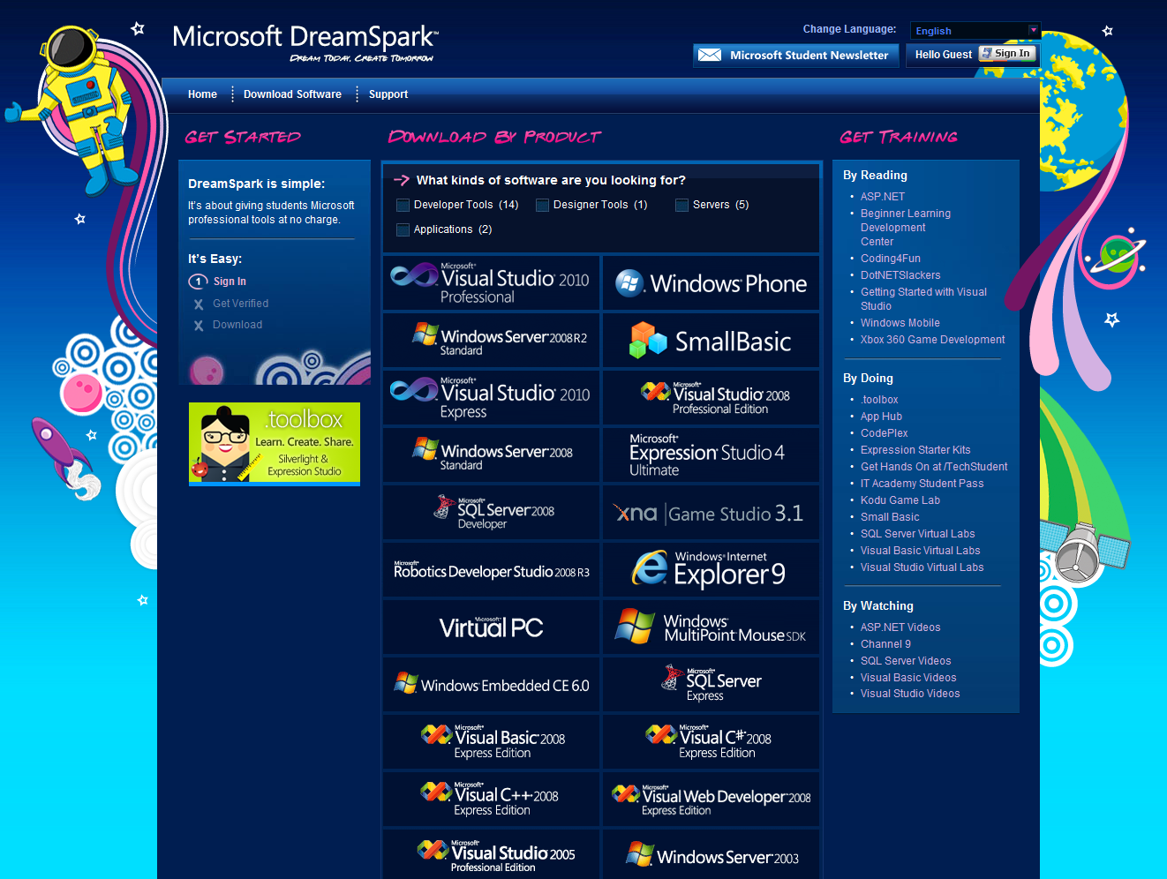
Getting Started (cont.)
DreamSpark -
Free Software for Students
https://www.dreamspark.com/

Slide 4
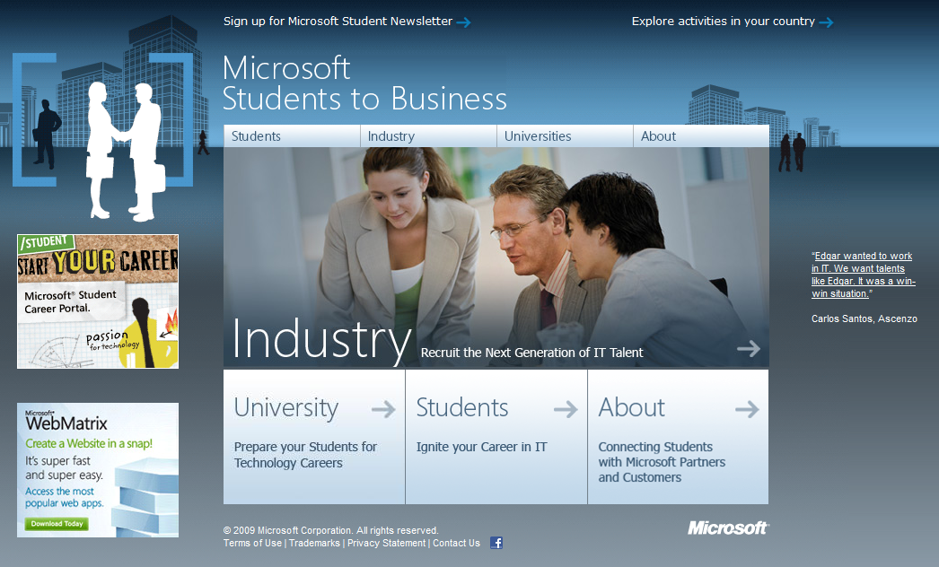
Getting Started (cont.)
Students To Business -
Business Connections for Students
http://www.microsoft.com/studentstobusiness/home/default.aspx

Slide 5
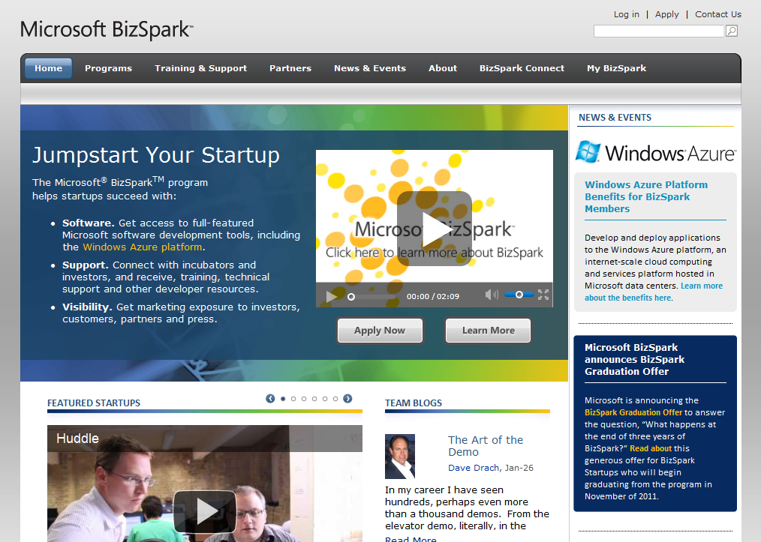
Getting Started (cont.)
BizSpark -
Free Software for Startups
http://www.bizspark.com

Slide 6
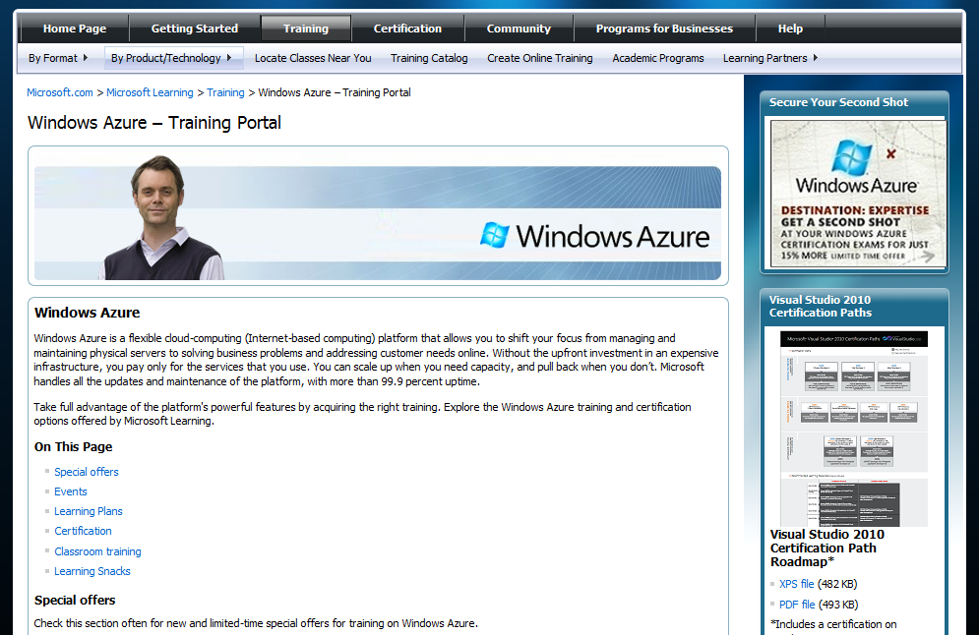
Getting Started (cont. – and end!)
Training Portal for Azure
http://www.microsoft.com/learning/en/us/training/azure.aspx

Slide 7


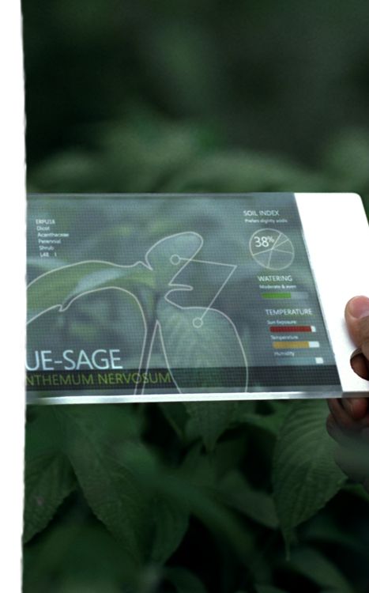


Expressions
Natural & Engaging
Connections
Seamless & Personalized
Insights
Contextual & Anticipative
TOMMOROW

