Slide 1
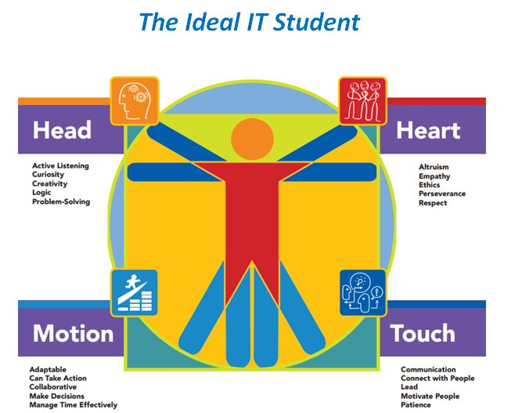
Partnering with Industry
BECAUSE of industry PARNTERNSHIPS the Center of Excellence for Information & Computing Technology has been able to provide a variety of services, research, professional development opportunities, to support CTC faculty in offering the most current education/training in information technology’s technical and employability skills to our state’s community and technical colleges students. This ensures our IT graduates are successfully prepared to enter the state’s workforce and contribute in a meaningful way that keeps the state’s IT industry moving.

Slide 2
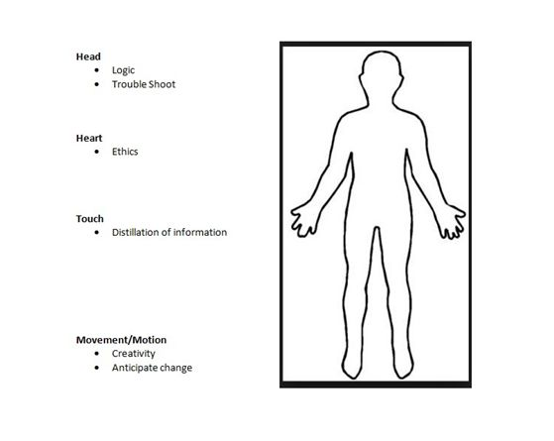
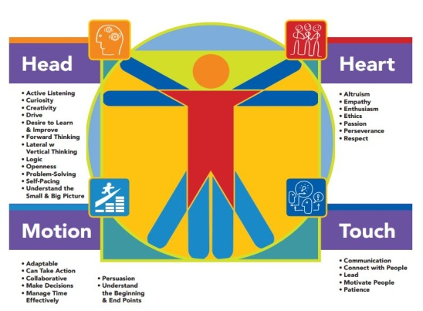
A new report, Building an IT-Ready Washington: 2015 and Beyond, the Center produced will be used to demonstrate how industry partnership consistently produce tangible results that directly impact all of the work the Center conducts and produces.
The report, created by the Center and its IT industry professional partners serves as a practical resource for IT faculty and student. It offers sound, practical tips, tools, and resources to improve the quality of the classroom experience as well as generate more well-rounded and work- and IT-ready graduates.

Slide 3


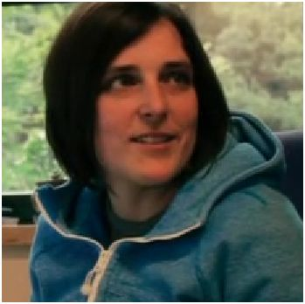


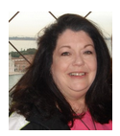
Who are our panelists?
Jonny Chambers, Microsoft
Rich James, F5 Networks
Eden Lasatar, Bellevue College
Chris Orth, Game Dev. Education
Juan Ulloa, EagleView Technologies
Valerie Goulds, Microsoft

Slide 4
They will tell you…
name, title, (what they do)
organization/company, (what it does),
state one way you think your partnership role/activity with the Center made a difference for our IT faculty and students, and
share one new and/or emerging technology trend you believe will impact the tech landscape of 2015.

Slide 5
What we will be talking about:
To put each panelist’s contribution into context, the Center will outline some of the initiatives, activities, projects/products, and then ask our panelists to share their answers from the report we outlined at the start of this session, put it into perspective, and have them expand on their answer.

Slide 6

Reports, White Papers, Webinars
The Center performs Research and produces Reports, White Papers, and Findings: Annual, consistent industry and workforce research is scanned and analyzed to support the aforementioned IT reviews, as well as reports and presentations.
Industry provides their own objective/subjective perspectives in areas like software and web development, networking, gaming, web design, data analytics, etc. and/or validates Center research.
Outcomes:
Changes are made to IT programs to reflect the following:
IT industry creating new career pathways as well as movement towards the adoption of new technologies
Transformations to IT career pathways that will impact academic pathways,
A need for a new, or modified IT program of study,
New degrees and/or certificates, including Baccalaureate of Applied Science degrees

Slide 7
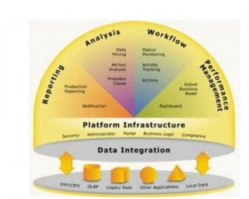
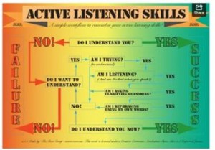
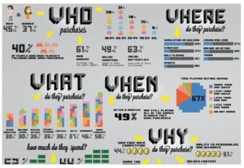
Jonny Chambers & Chris Orth will now share their insights on two of the questions answered within the report:
1. What new technology competencies should the IT graduate be anticipating and searching out to master either in college, a training program, opportunities provided online, or by self-mastery (reading a book, or IT content-specific website)?
2. Often, IT employers bemoan the lack of innovation and critical thinking in an IT graduate. Why do you think that is? What could the student do to “grow” their own capacity to innovate and think critically?
Chris: “Integration with Outside Technical Systems: The future will be defined by data and interactions flowing in new and unexplored ways between seemingly disparate groups of people.”
Jonny: Listening - It Takes Practice and
Asking the Right Questions
Notes:
Jonny Chambers & Chris Orth base on these two questions will:
Give examples of how and why research (reports, webinars, etc.) is important to:
Identify what are new and/or emerging technologies that IT programs and students should be anticipating in order to “refresh” their programs,
Research and build new degrees, including four-year degrees, and certificates
Also, why employability skills are so vital to the success in the workplace for IT graduates. Why do all of our IT partners recommend that students seek out additional learning opportunities outside the classroom?
How can HR encourage, build, strengthen professional development opportunities (especially non-traditional “let’s send someone to a conference or a week-long training session) for their employees and what to look for on a resume or in-person interview that will help them identify strongest candidates who actually practice IT life-long learning?
Go over why it’s important and then offer your own take on how to develop this skill (active listening) and (not to wait until you are in the workplace to actually develop it).
Why is it important to ask questions – and give an example using the five “Ws”.
How can workforce educators and HR professionals create opportunities for IT professionals to develop this crucial skill?
What additional communication skills are critical in the workplace?

Slide 8
Events
Industry consistently contributes to these events as either a panel member, today this group is giving us a real-time example, in work groups with IT faculty in reviewing degrees, answering specific questions about new and emerging technical knowledge and skills, new applications, developments in programming, how UX took off, etc.
They also serve as keynote speakers and presenters.
They volunteer and provide their valuable time, share their experiences in the workplace, help with predictions that ultimately impact the advice that the Center gives to faculty across the state. The list of how critical they are to the Center’s impact on IT education is endless.
Their unique instances of participation and contributions number in the mid- to high 100’s over the last seven years.
Outcomes:
Two examples…
Careers in IT: The Real Story is an event the Center has and will continue to offer is aimed at increasing the awareness and interest level in secondary students considering pursuing an academic and career pathway in IT.
IT Futures Summit(s)/STEM Summits, etc. has provided
Professional Development for hundreds of faculty who then update their curriculum to reflect new developments in technology
Policy and Efficiency-Development Across the CTC system: IT Faculty have developed a series of common IT courses (6 and counting for 15+ participating colleges) that reduce duplication for a student who transfers to a different WA state CTC, meaning they don’t have to retake the course, audit it, pay for prior learning assessment, etc., as well as constructive collaboration on developing a number of the state’s IT Applied Baccalaureates which create opportunities for students to complete a four-year degree at the same college they completed their first two years at. Or, they can transfer to another CTC to earn a bachelors in an IT academic/career pathway that appeals to them, like data analytics, software development, or networking/security.
Notes:
Events: The CoE for ICT hosts a number of annual events, as well as new events and activities. There are three main philosophies underlying these events:
To offer K-20 educators professional development opportunities in new and emerging information and computing technology
To connect ICT educators and industry in order to benefit the advancement of program curriculum and best practices that ensure we are preparing our students for successful placement and careers in the IT profession
To offer students opportunities to increase their awareness and interest in careers in information and computing technology

Slide 9
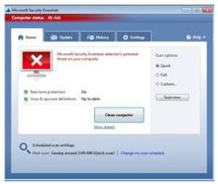
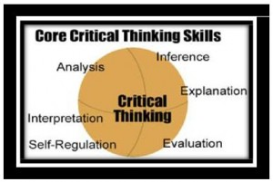
Security: “Data loss”, “data breach”, “abuse of cloud services”… It all sounds ominous. Network security, specifically security for the cloud, is important. The Cloud Security Alliance listed the “notorious nine” threats. This is a well-organized and succinct overview of the nine security threats to the cloud.
Critical Thinking: Everyone always talks about how important critical thinking skills are. However, there is something vague about this term, as there are a myriad of definitions out there.
“Critical thinking is the ability to think clearly and rationally.It includes the ability to engage in reflective and independent thinking.
Eden Lasater and Valerie Goulds will now share their insights on three of the questions answered within the report:
1. What are the top five IT courses (and subsequent IT concepts/competencies) they should have mastered? (For example, networking, programming, database design/development, etc.)
2. What are the top five academic concepts/competencies they should have mastered? (For example, English, statistics, project management, general business, etc.)
3. What are the top three soft or employability skills you would expect them to employ in the workforce?
Notes:
Security: This is a well-organized and succinct overview of the nine security threats to the cloud. Anyone can quickly assess what the threats are just by reviewing the table of contents. However, as it’s only 19 pages, it might be worth reading.
What does it really mean? And, can it be taught? The following definition seems to capture the essence of critical thinking.
understand the logical connections between ideas
identify, construct and evaluate arguments
detect inconsistencies and common mistakes in reasoning
solve problems systematically
identify the relevance and importance of ideas
reflect on the justification of one’s own beliefs and values”
(Source: Critical Thinking)
The following resource and Critical Thinking Planning Guide (above) can be used by both IT educators and students to use in IT courses in order to build a critical thinking improvement plan. (Source: Educational Technology and Mobile Learning)
Troubleshooting: Troubleshooting is both a technical skill and an employability skill. Troubleshooting in the IT world is typically associated with hardware, networking, software, systems, etc. IT students should understand customer service often plays a large role in successful troubleshooting efforts. So, there is not only technical knowledge needed, but being able to incorporate active listening, proper documentation, patience, and clear communication are all essentials of effective customer service. There are a number of troubleshooting forums and vendor-specific resources online. Here are a simple series of steps to consider when troubleshooting an IT problem.

Slide 10
Services
The Center Performs a variety of Services - IT Reviews are one of the more popular and widely used services: Degrees, Certificates, and Baccalaureate Applied Science (curriculum, proposals, labor data/workforce demand, and current and emerging technology trends).
Since 2010, 35 IT reviews have been performed for almost 90% of the colleges that have IT programs.
Industry provides subject matter expertise, reviews curriculum, makes recommendations for both technical and employability skills that should be incorporated into the classroom.
Outcomes:
Add value to the CTC system by increasing the quality and relevancy of IT technical knowledge and skills, including employability skills of student graduates to increase workforce preparedness, efficiencies, and employability success.
Create awareness of IT industry changes that impact curriculum, as well as provide relevant and/or new technology trends analysis to faculty to increase IT program viability and vitality.
Notes:
Explain how what you do during the review process
review courses,
make suggestions to delete, update or add courses,
how you determine if the degree or certificate has been “composed” to prepare a student for a particular IT career pathway
how changes in career pathways impact the decisions you make because you are either involved in hiring or actually employed as a IT professional – in your case, Juan as a web developer, designer, UXr, etc.
how you scan, analyze, and recommend particular employability skills should be embedded into the curriculum.
And, anything else that comes to mind.

Slide 11
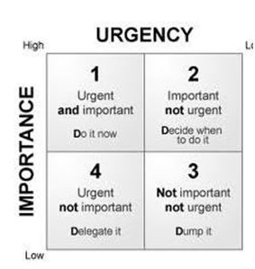
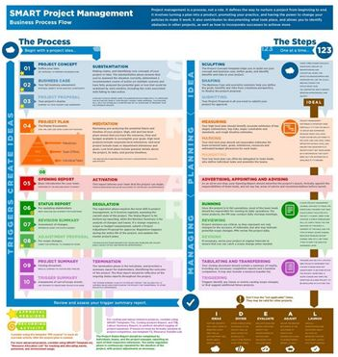
Deadlines and Time Management: Everyone knows what a deadline is. Something (a product, project, etc. with pre-specified elements) someone committed to do is due on a specific date to a specific person. Understanding
1) what a deadline is,
2) different types of deadlines, and,
3) what are the responsibilities as the person who has to meet a deadline or the person who is expecting a deadline to be met with a deliverable.
Business Processes: “Another area where IT students can improve upon is their understanding of business processes. IT students who enter the workplace must expect that there are steps to follow and take time to know the reasons for the process.”
Rich James and Juan Ulloa will now share their insights on one of the questions answered within the report:
When you are training and/or mentoring a new IT employee, what three things do you spend the most time on with them to improve their performance?
Notes:
Rich this is your point – Understanding Business Processes. Must expect there are steps to follow and take the time to understand reasons for process.
Use it and then give a concrete example of it’s important in the workplace and
what education and HR should focus on and/or introduce it in the classroom or as part of training, or
how HR could screen for this type of technical/employability skill.
If there is some additional thoughts on this, please share them.
A business process is a collection of related, structured activities or tasks that produce a specific service or product (serve a particular goal) for a particular customer or customers. There are three main types of business processes:
Management processes that govern the operation of a system. Typical management processes include corporate governance and strategic management.
Operational processes that constitute the core business and create the primary value stream. Typical operational processes are purchasing, manufacturing, marketing, and sales.
Supporting processes that support the core processes. Examples include accounting, recruitment, and technical support.
(Source: Wikipedia)
Juan – This is your point. Time management.
Use it and then give a concrete example of it’s important in the workplace and
what education and HR should focus on and/or introduce it in the classroom or as part of training, or
how HR could screen for this type of technical/employability skill.
Add in anything else that you want to explore here.
These are all critical concepts for an IT student and worker.
Deadlines are related to time management, and sharing time management tips with IT students will serve them will when they enter the workforce.
The Fail Date: This is considered the “test” deadline. If you fail to meet this type of deadline, you won’t be asked back to work on a project for the group, company, contractor, etc. You’ll know it’s a fail date deadline because the timeline seems unrealistic, a need for frequent updates will be part of the project specifications, and you are asked if there is a possibility of completing the project early. If you think you can actually meet the deadline, then break the task down into multiple parts with hourly deadlines. If you think it’s a fail date deadline project, then either counter with a realistic deadline for deliverables or pass on the project.
Firm, but Flexible: This is the most common type of deadline. The deadlines are “firm,” but there is a chance they won’t be met due to unexpected issues that might arise. Find out why there is an aura of ambiguity around some or all of the deadlines. If the project authors actually know that some of these deadlines might be missed because of the unexpected issue, what aren’t they telling you? Find out. Is it because another part of the project has been farmed out to another person or group and you will have to wait for them to complete their part of the project? This type of deadline is something you can succeed with. It just might take a bit of perseverance and patience on your end.
Stale Date: Stale Date deadlines are attached to a project that isn’t really expected to go anywhere. It might be a pet project of someone at the top level of management that produced a lot of initial excitement and then is forgotten about as other projects receive higher priority, or it’s a project that doesn’t have actual resources attached to it and fades away as time goes by. Deadlines for these types of projects require acknowledgement of the deadline, keep it on your horizon, but expect that eventually no one will even remember what it was about. (Source: Adapted from Gigoam.com)
Other Resources to Consider:
The Deal on Deadlines and What They Teach US, LinkedIn
10 Time Management Tips that Work, Entrepreneur

Slide 12

Q&A and Thank You
Now we will take some time for any questions from the audience, and or final thoughts from our panelists.
Thank you to the panelists.
Thank you to the audience, conference team, and Bellevue College.
Find out more about the Center at
Coeforict.org
maureen.majury@bellevuecollege.edu

