Slide 2
M
Moore’s Law
Moore’s Law – the number of transistors per square inch double every year and computing speeds double every two years.

Slide 3
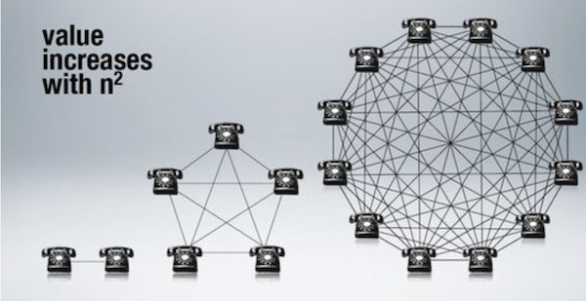
Metcalf’s Law
Metcalf’s Law – telecommunications network is proportional to the square of the number of connected users of the system.

Slide 4
2020 ?

Slide 5
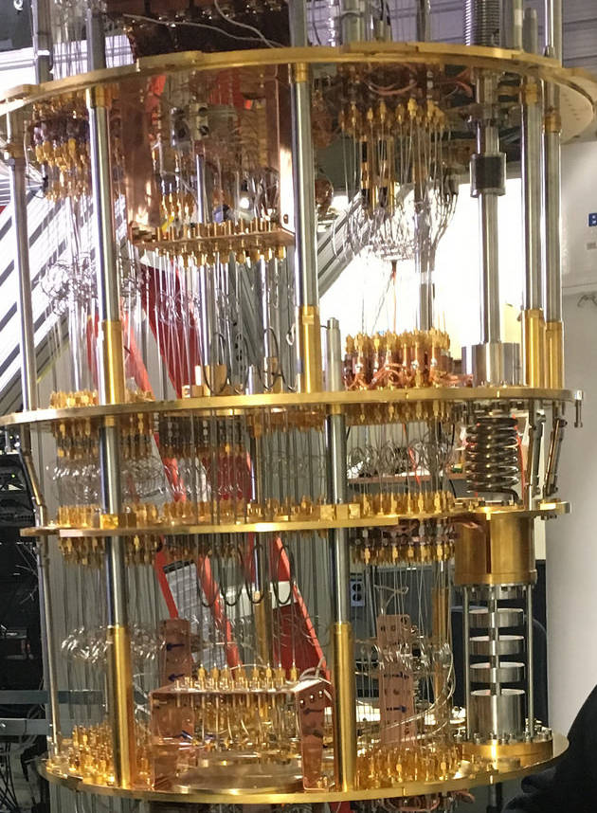
Quantum Computing
IBM 5 qubit machine on a single cryogenic chip represents the birth of quantum cloud computing.

Slide 6
Leverage digital platforms
Imbed learning in every process
Empower people with AI imbedded in anything
Jobs will change – we need to prepare for them
Blockchain – doing for transactions what data did for the internet
Data bases onto the cloud – 250 million events can go in one day
Computers the size of a grain of salt
Gig speed of throughput
Improve analysis in finances
Accelerate space
Solve problems that are now impossible to solve

Slide 8
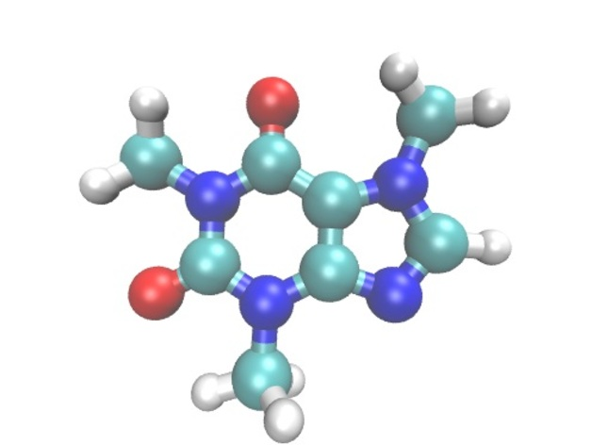
Caffeine molecule

Slide 9
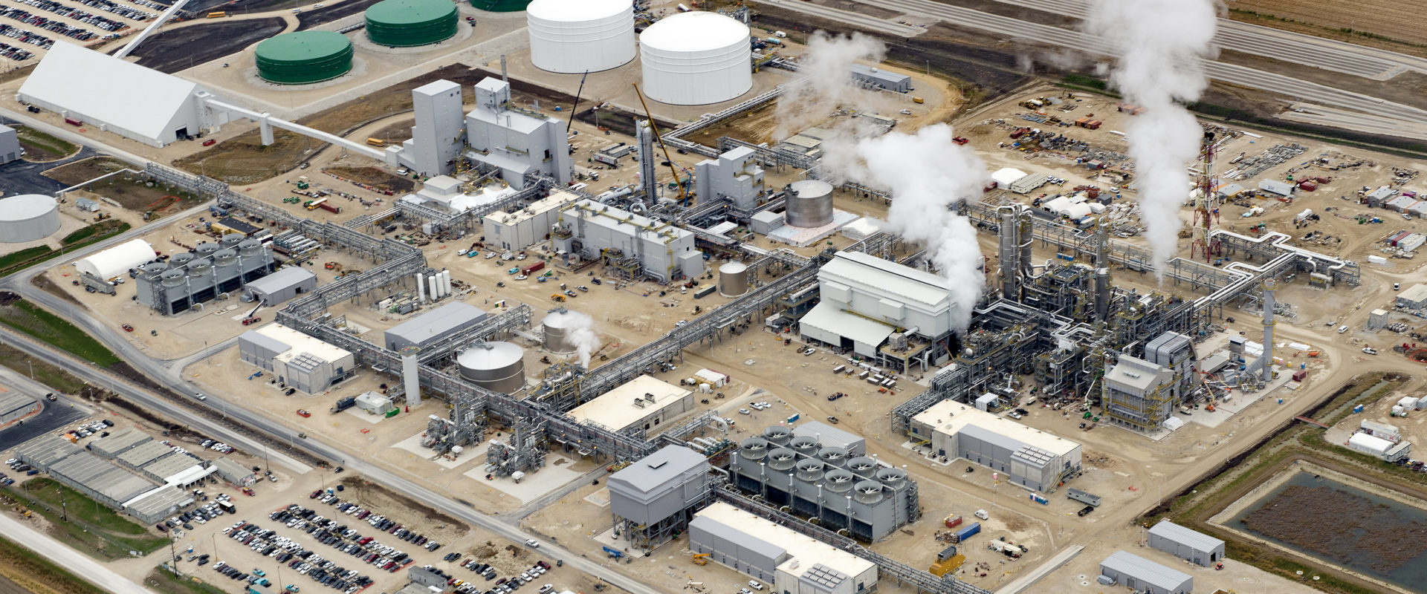
IOWA Fertilization plant

Slide 10
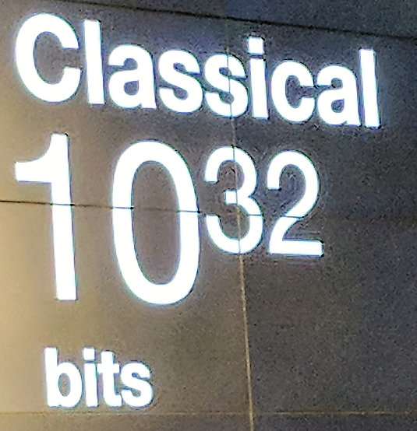

Slide 11
Quantum
108
Qubits

Slide 12
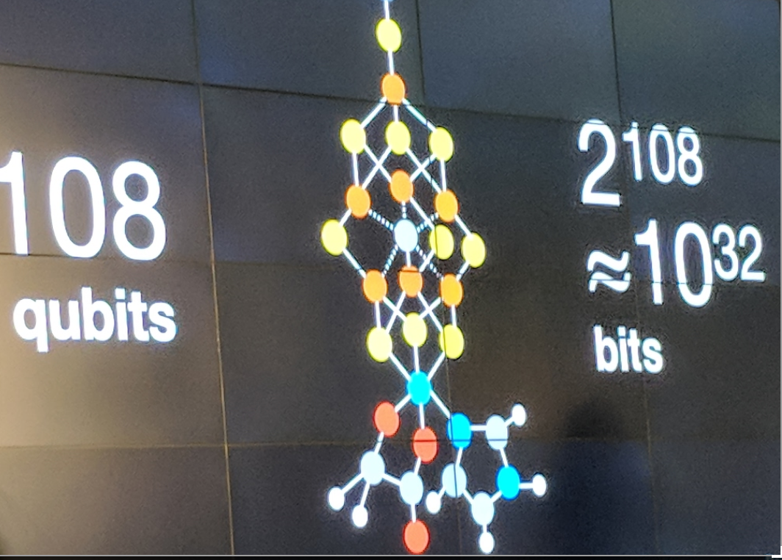

Slide 13
How does quantum computing work?

Slide 14
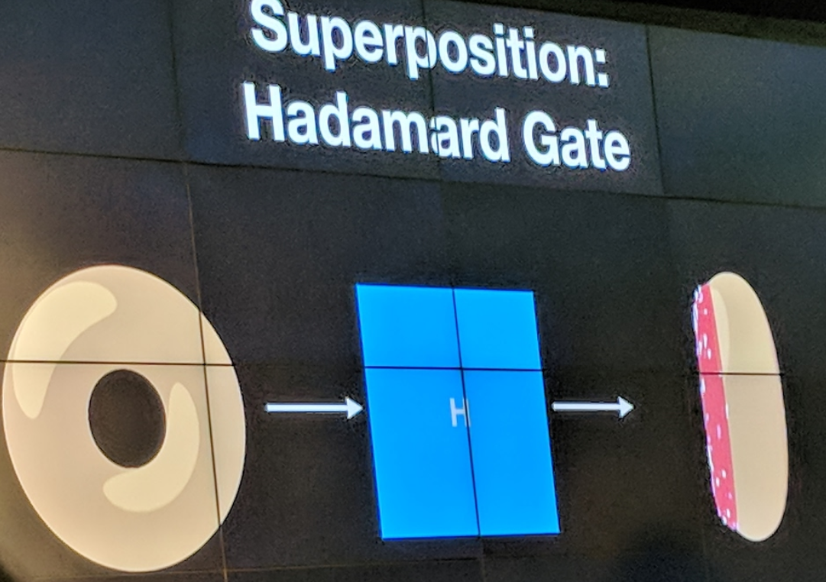
Superposition

Slide 15
Entanglement

Slide 17
IBM Q-Experience
https://quantumexperience.ng.bluemix.net/qx/experience
Explore the world of quantum computing! Check out our User Guides and interactive Demos to learn more about quantum principles. Or, dive right in to create and run algorithms on real quantum computing hardware, using the Quantum Composer and QISKit software developer kit.

Slide 18
Education
Reimagined

Slide 19
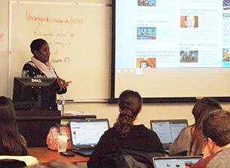

Slide 20
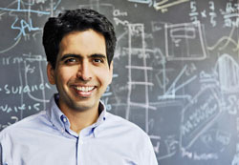
SAL KHAN, KHAN ACADEMY

Slide 21
WHY Khan Academy
so successful?
Learn more if they can fill in the gaps
Builds a foundation
Independence

Slide 22
FILL IN THE GAPS

Slide 23
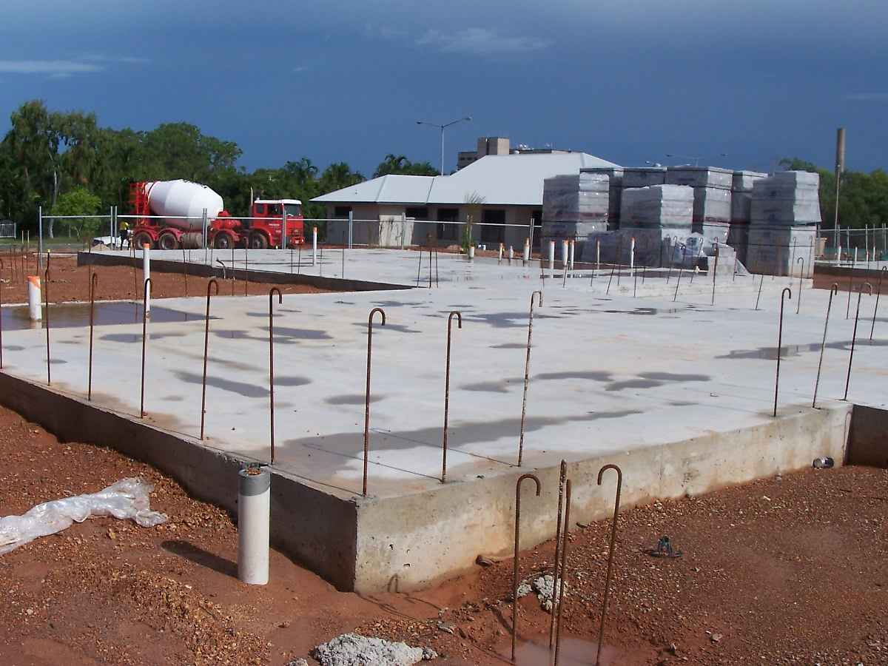
Build a Foundation

Slide 24
PSAT
SAT
20 hours 100 points improvement
1 day week, learn on their own pace, have 30% gain
How will it benefit YOUR class and YOUR students?

Slide 25
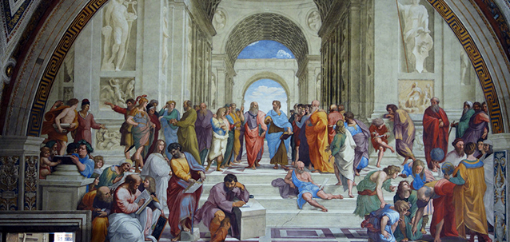
Western Europe 400 years ago

Slide 26
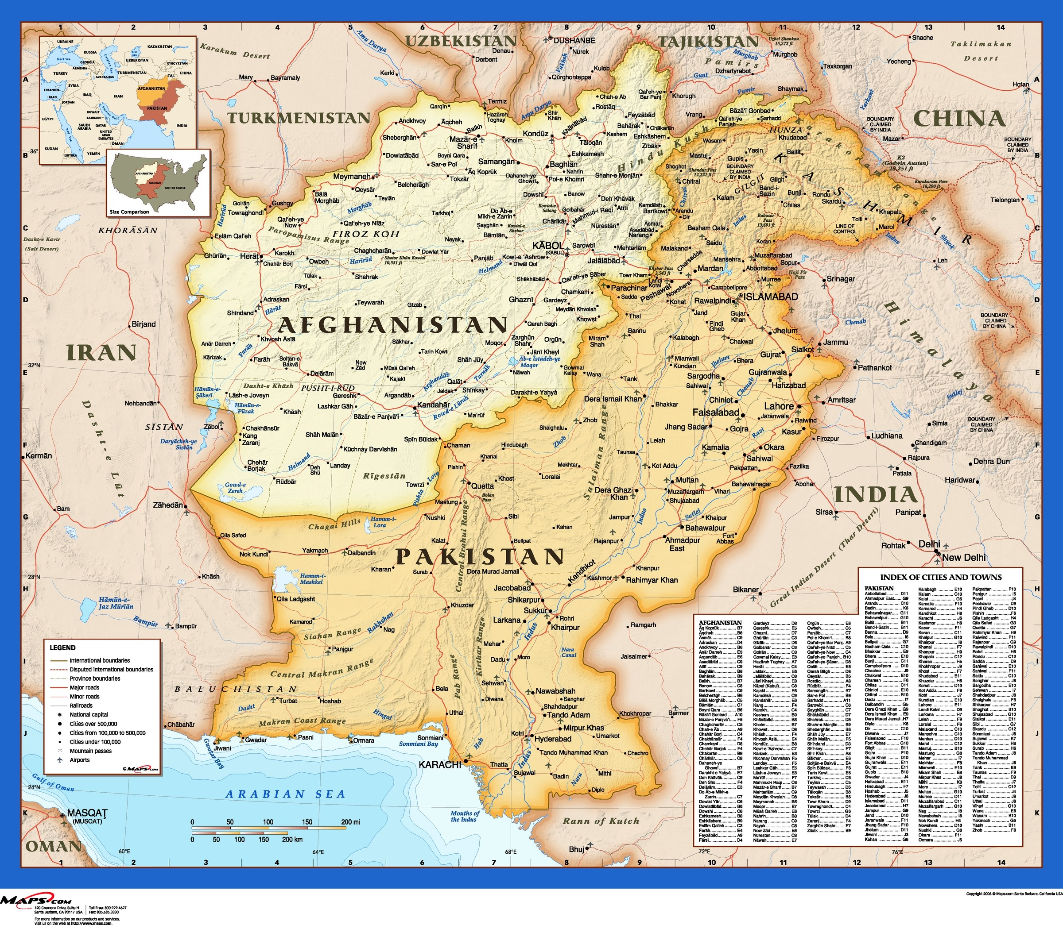

Slide 28
References
https://www.google.com/search?q=moore%27s+law++graphic&client=firefox-b-1-ab&tbm=isch&tbo=u&source=univ&sa=X&ved=0ahUKEwjPj_P1qYjbAhVrrVQKHT3dCbgQsAQIKA&biw=1540&bih=811#imgrc=3OH09DQbifeU-M:
https://www.google.com/search?q=metcalfs+law+images&client=firefox-b-1-ab&tbm=isch&tbo=u&source=univ&sa=X&ved=0ahUKEwiJxcvgrYjbAhXJwFQKHfENAcUQ7AkIOA&biw=1540&bih=811#imgrc=8h9L2MMTzLe3YM:
https://www.electronicsweekly.com/news/research-news/ibm-puts-quantum-computer-on-line-2016-05/
https://www.google.com/search?client=firefox-b-1-ab&tbm=isch&sa=1&ei=Ry37Wo-nDeiV0gKgipQI&q=OER+teacher+standing+in+front+with+class+image&oq=OER+teacher+standing+in+front+with+class+image&gs_l=img.3...26458.27826.0.29524.4.4.0.0.0.0.54.182.4.4.0....0...1c.1.64.img..0.0.0....0.-4DBFs7c51c#imgrc=jizum3fcozS1XM:
https://www.google.com/search?q=Sal+Khan+image&client=firefox-b-1-ab&tbm=isch&tbo=u&source=univ&sa=X&ved=0ahUKEwi1_tfptojbAhXphVQKHYssDEgQ7AkISg&biw=1540&bih=811#imgrc=D5YMoZ4FThTSJM:
Music
"Take a Chance" Kevin MacLeod (incompetech.com) Licensed under Creative Commons: By Attribution 3.0 License http://creativecommons.org/licenses/by/3.0

Slide 29
Resources cont.
https://1800foundation.com/think-choose-slab-foundation-home/
https://www.google.com/search?q=mongolia+orphanage&client=firefox-b-1-ab&tbm=isch&tbo=u&source=univ&sa=X&ved=0ahUKEwiUsbrRuIjbAhVI4VQKHUJNA5EQsAQIVA&biw=1540&bih=811#imgrc=XhamDbWNeXg17M:
https://www.google.com/search?q=fill+in+the+gaps+image&tbm=isch&source=iu&ictx=1&fir=k-poYJUuAgNtpM%253A%252C276UKTmvdyoAEM%252C_&usg=__EMqSQp-aHY7yA9DvyY71sZoQN9U%3D&sa=X&ved=0ahUKEwjm-InO1YrbAhUTz2MKHXqFDyAQ9QEIPTAJ#imgrc=k-poYJUuAgNtpM:

