Slide 1
IT futures Summit 2018
Welcome and let’s #techitup

Slide 2
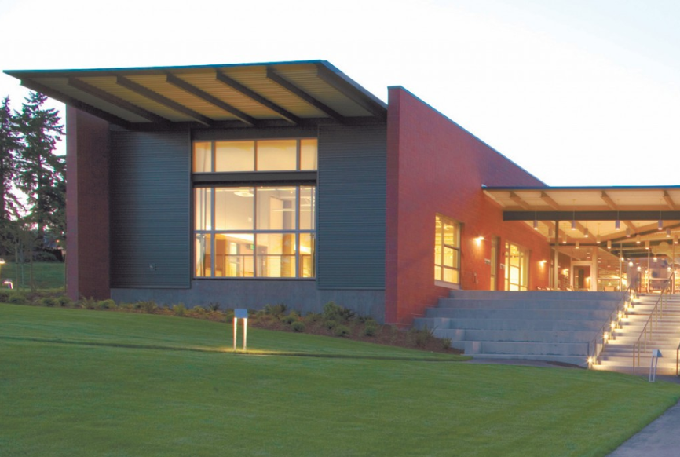
Introductions:
Name
College
What Do You Teach

Slide 3
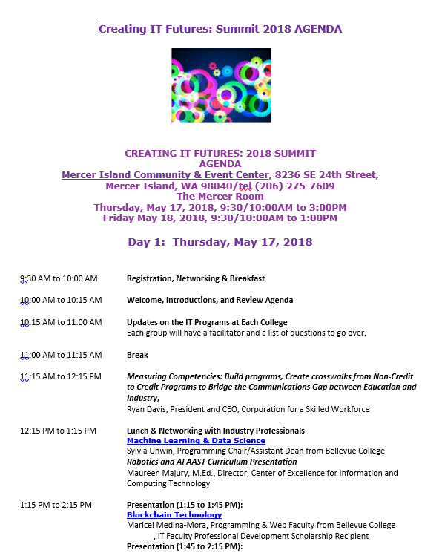
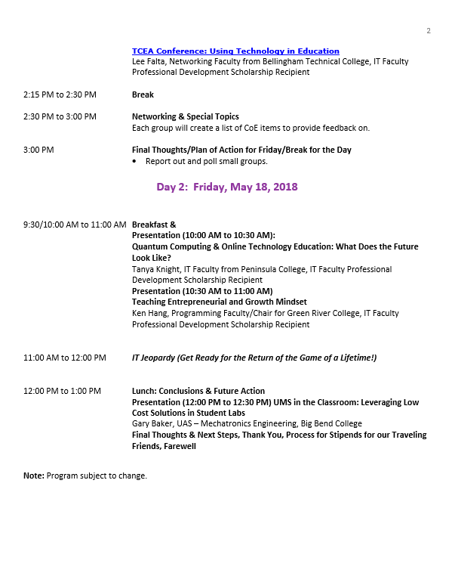

Slide 4
Update: robotics/AI
The Robotics/AI AAS/BAS for Bellevue College: Sharing Curriculum for Interested Colleges

Slide 5
Progress To-Date
Since 2014 the Center has been researching robotics and artificial intelligence (AI) technology, occupations, technical knowledge and skills, and programs of study in robotics/AI, current degrees offered at 4-year institutions like Carnegie Mellon (masters) and the University of Groningen in the Netherlands (bachelor’s of science).
This led to the development of an outline of possible AAST/BAS degrees. Bellevue College expressed interest in offering the AAST/BAS, with the understanding that the curriculum developed would be shared with the system (those colleges that were interested in offering the introductory course, a certificate, and/or a degree).
The AAST Robotics/AI (ROBAI) was approved recently and will launch Fall 2018. If all goes well the BAS will be offered Winter 2019.
The degree can be viewed here. The degree can be downloaded and viewed here.
For any interested college, please contact the Center director prior to June 30, 2018 if you are interested in offering any of the courses, a certificate, or degree. The four AAST course outlines will be emailed to you, and the Canvas courses can be exported to those who want to offer the courses (just import the content).
Questions?

Slide 6
Project (2018-2021): IR4: A Mobilized Washington State A Systemic Approach to Prepare Washington State’s Community and Technical College Information Technology Programs for the 4th Industrial Revolution
IT employers are faced with industry changes caused by disruptive technologies and confront a rapidly growing skills gap; they want workers who can rapidly adapt/adopt their technical knowledge and skills for new developments in IT. If this need is not met, what do they do?
There appears a growing list of new occupations, a sizeable increase in the number of job demand for specific job titles, or new requirements (technical knowledge and skills) that align with these disruptive technologies. A few examples of these occupations include:
Automation Developer
Data Scientist and Insights
Deep Learning Specialist
Computer Vision Specialist
IoT Architect or Developer
Machine Learning Specialist
Software Developer for Digital Care, Chatbots, Elearning

Slide 7
Solution: Create and/or offer the following: 1. Develop an online learning portal for faculty. Research and provide IT faculty access to either subscription or free online learning opportunities. 2. Create a custom training plan for individual IT faculty to learn and upskill in the following areas: robotics/AI, IoT, in the first stage, then Data Science and Ethical Hacking in the second stage, then move onto Advanced Web and Software Development in the final stage. 3. Work with IT faculty to review their IT programs and create redesigned courses in order to develop an updated program of study in the areas defined above. This might include offering the introductory course in these IR4/disruptive technology areas, and new or redesigned certificates or degrees. 4. Develop a master plan on how to ensure new certificates and degrees offer solid and achievable internships and/or work-based learning experiences in Capstone courses. This might include developing an online portal for local employers to offer temporary work experiences that senior-level employers don’t have time to do themselves. This is a comprehensive project that has a systemic approach in updating the IT programs of community and technical colleges across the state. This project’s products/services will be offered at no cost to participating colleges.

Slide 8
If we have time, questions? Thank you for your time!

